Slide 1
Budget Sales Analytics
Project by –
Archana Malviya

Slide 2
Project Details-
Project Title- Budget Sales Analytics
Technologies -Data Science
Domain- Retail & Sales
Project Difficulties level -Advanced
Tools Used – Power BI & DAX Function

Slide 3
Objective-
Extract various information such as Sales, budget, and variance.
compare sales and budgets with various attributes.
Extract necessary information about Products and Customers
Make the necessary dashboard with the best you can extract from the data.

Slide 4
DataSet Information-
There are two Worksheet for Budget
1. Budget
2. Adventure Works Database-
Calendar
Customer
Products
Sales
Territory

Slide 5
Detailed Description:
We calculated and make some important new Measure with DAX function
which are needed for calculation are-
DAX Function New Measure
Average Unit Cost = AVERAGE(Sales[UnitCost])
Average Unit Price = AVERAGE(Sales[UnitPrice])
Cost = SUM(Sales[TotalProductCost])
Cumulative of last year revenue = CALCULATE([LAST YEAR REVENUE],FILTER(ALLSELECTED(Calender_2),Calender_2[Date]<=max(Calender_2[Date])))
Cumulative Revenue = CALCULATE('Budget 2016'[Revenue],FILTER(ALLSELECTED(Calender_2),Calender_2[Date]<=max(Calender_2[Date])))

Slide 6
diff profit margin = if(ISBLANK([Profit Margin LY]),BLANK(),[Total Profit Margin]-[Profit Margin LY])
difference between in current yr and last revenue = [Cumulative Revenue]-[Cumulative of last year revenue]
LAST YEAR REVENUE = CALCULATE('Budget 2016'[Revenue],SAMEPERIODLASTYEAR(Calender_2[Date]))
Profit Margin % = DIVIDE([Total Profit Margin],[Revenue],0)
Profit margin contribution % = DIVIDE([Total Profit Margin],CALCULATE([Total Profit Margin],ALL('Product'),ALL(Territory),ALL(Customers)))
Profit Margin LY = CALCULATE([Total Profit Margin],SAMEPERIODLASTYEAR(Calender_2[Date]))

Slide 7
Revenue = SUM(Sales[SalesAmount])
Revenue contribution % = DIVIDE([Revenue],CALCULATE([Revenue],ALL('Product'),ALL(Territory),ALL(Customers)))
Sales Qty = sum(Sales[OrderQuantity])
Target difference = [Profit Margin %]-'Profit Target'[Profit Target Value]
Total Profit Margin = SUM(Sales[Profit Margin])
Total Spend = SUMX(Sales, Sales[OrderQuantity] * Sales[UnitPrice] )

Slide 8
Target sales = SUM(Budget[Total Budget])
Variance = 'Budget 2016'[Revenue]- 'Budget Monthly'[Target sales]
Variance % = DIVIDE([Variance],[Target sales])
Profit Target = GENERATESERIES(-0.05, 0.35, 0.01)
Profit Target Value = SELECTEDVALUE('Profit Target'[Profit Target])
Profit Margin = (Sales[UnitPrice]*Sales[OrderQuantity])-Sales[TotalProductCost]
Sales = SUM(Sales[SalesAmount])

Slide 9
TotalSales = SUM(Sales[SalesAmount])+SUM(Sales[TaxAmt])
UnitCost = Sales[TotalProductCost]/Sales[OrderQuantity]
This all Calculation in done is with DAX function.
Also created New Table called-
Budget 2016
Budget Monthly
Calender2
Profit Target

Slide 10
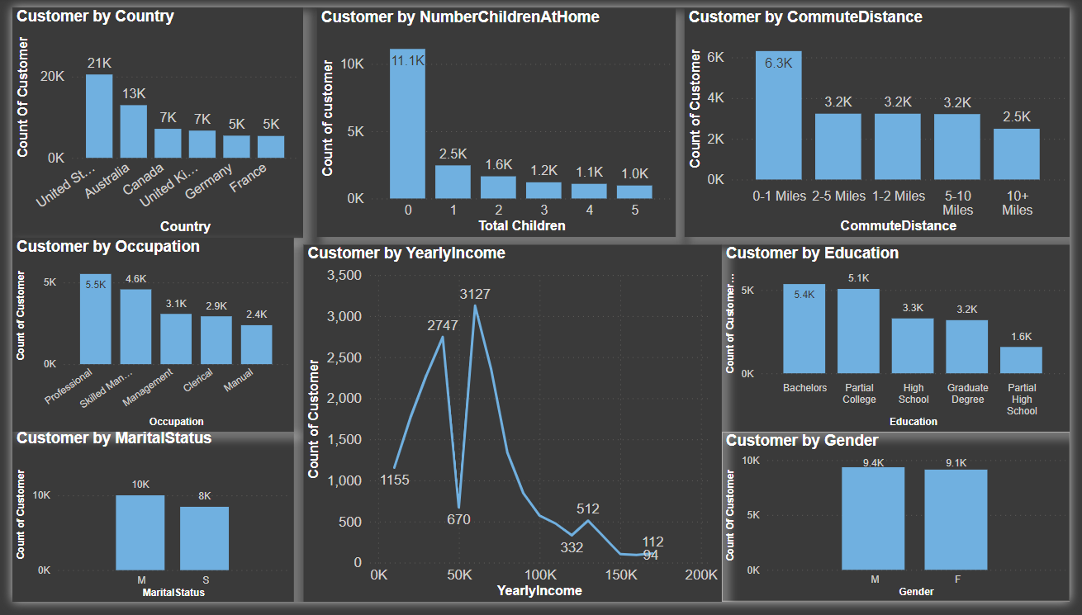
1.Customer Analysis
q

Slide 11
Insight-
We can see that in chart that United states is highest customer count compare to other country. Which is 21k afterwards customer counts decreases.
Count of customer is max for professional occupation.
Customer is mostly married.
Count of customer is max for yearly income of between 50k to 100k.
Most customer is with no children.
Customer count is maximum for nearest distance.
Customer count is maximum for educated bachelors.
Customer is mostly male but minor difference between male and female.

Slide 12
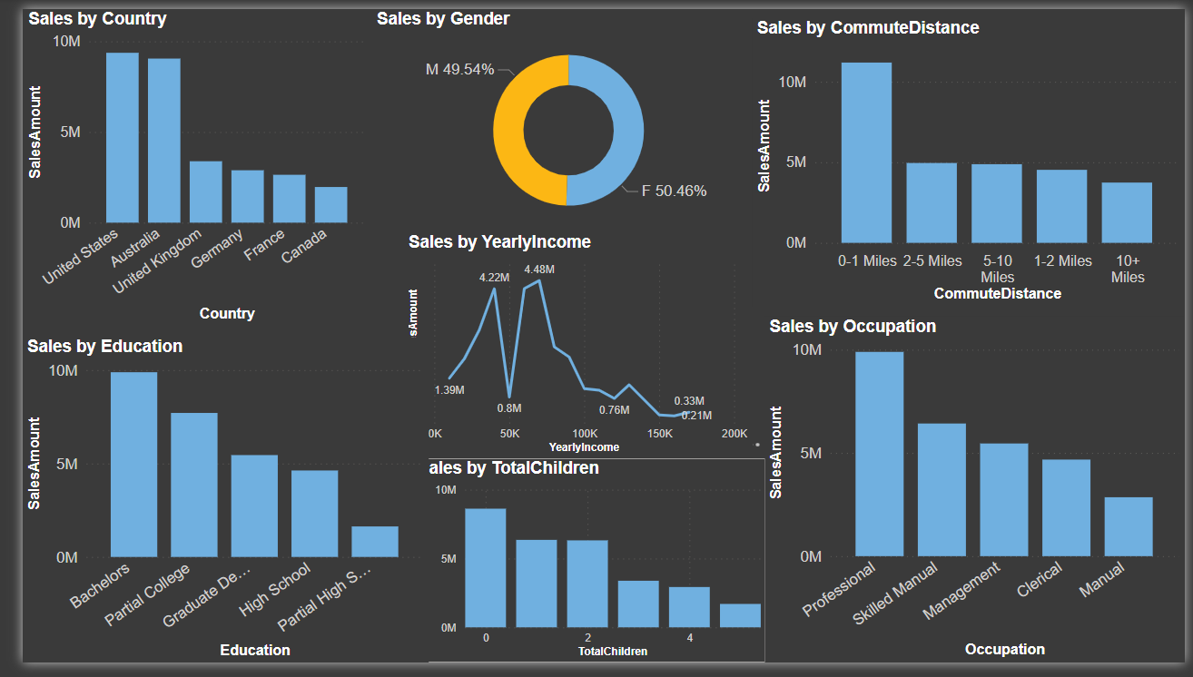
2.Customer Sales Analysis
e

Slide 13
2.Insight
United states has most sales least in Canada
Sales is maximum in bachelors.
Sales by gender is equal for male and female.
Sales is maximum for 50k to 100k yearly income customer.
Sales is highest for customer with no children.
Sales is maximum for customer who lived nearest distance
Sales is highest in professional

Slide 14
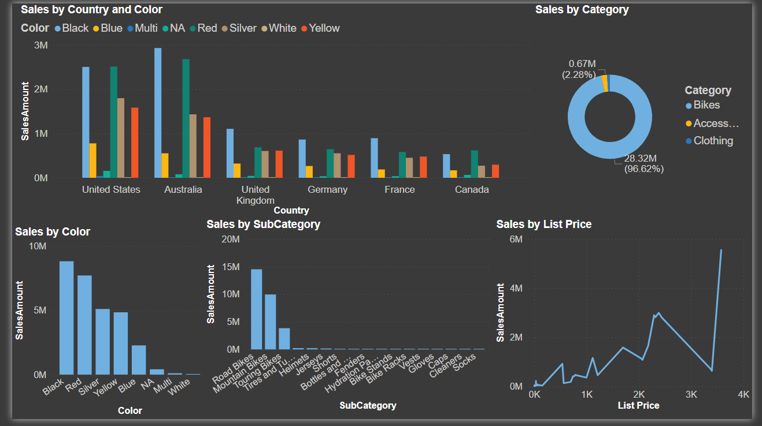
3.Product Sales Analysis
w

Slide 15
Insight
Sales of product by country is highest in Australia.
Black color have most sales.
Sales of product in sub category have most in Road Bikes.
Mostly bikes are sold with 96.6% .
List price is highest in between 3k to 4k .

Slide 16
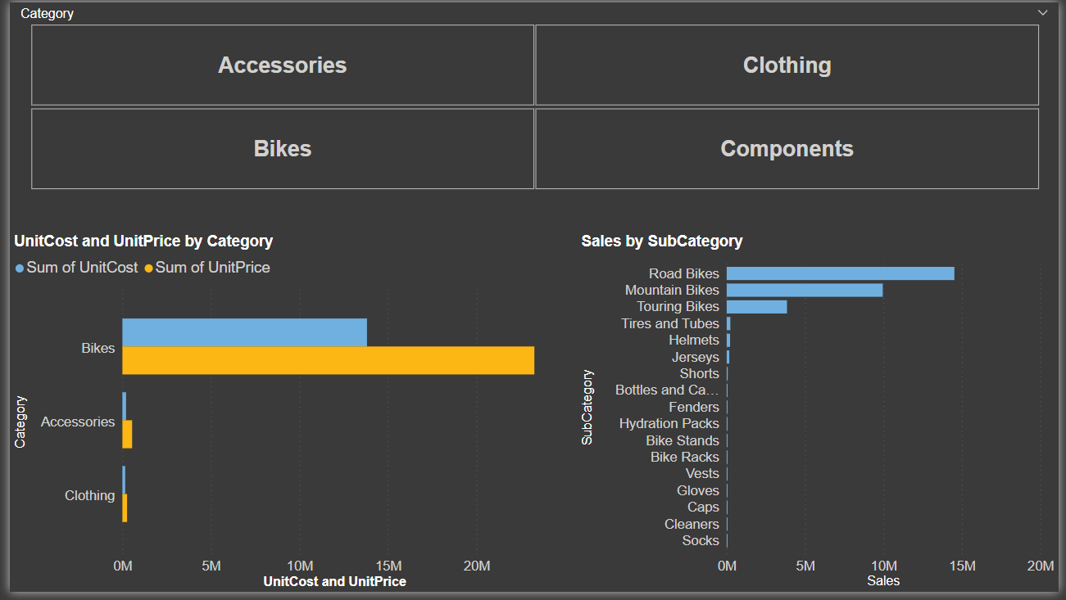
4.Sales Analysis

Slide 17
Insight
Unit cost and unit price is highest for Bikes category.
Lowest for clothing category.
Sales of Road Bikes is max in sub category

Slide 18
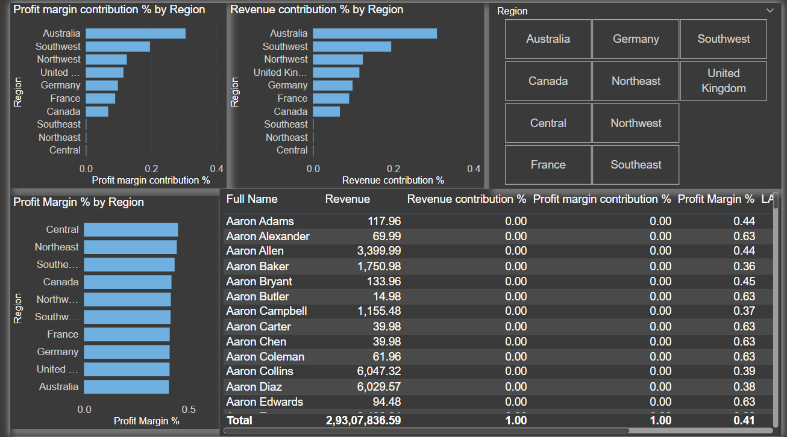
5.Profit Analysis

Slide 19
Insight-
Profit margin contribution % by region is maximum in Australia.
Profit Margin% is most in central region.
Revenue contribution % is maximum in Australia region.

Slide 20
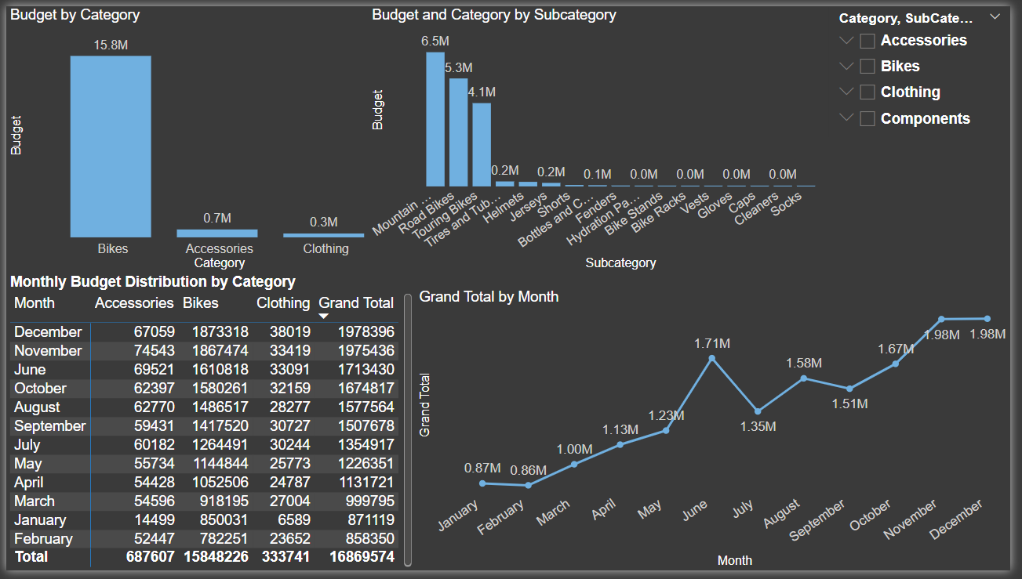
6. Budget 2016 Analysis

Slide 21
Insight
Budget in category is highest in Bikes and lowest in clothing.
Budget for category and for subcategory is highest for mountain bikes and least in socks.
Grand total for month 2016 is maximum for June month and
lowest in January month.

Slide 22
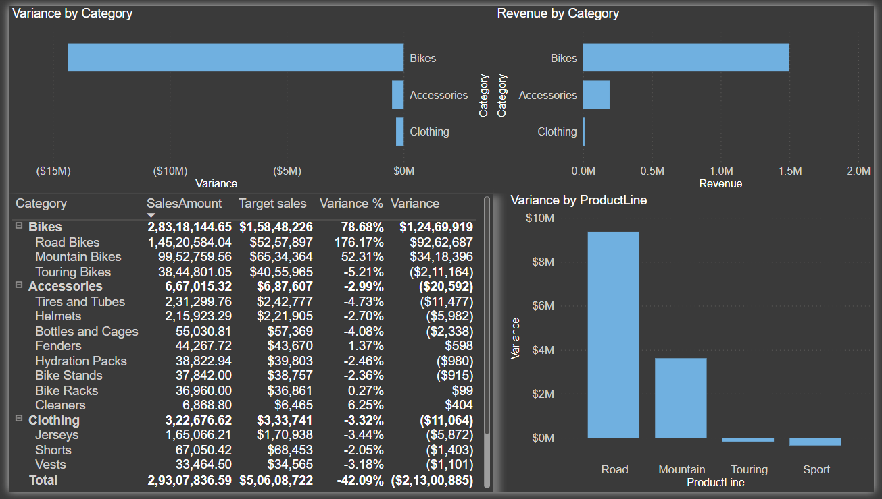
7.Variance Analysis

Slide 23
Insight
Variance in category is most for Bikes and least for clothing.
Revenue in category for bikes is highest and lowest for clothing.
Variance in product line is most for road and lest for touring.

Slide 24
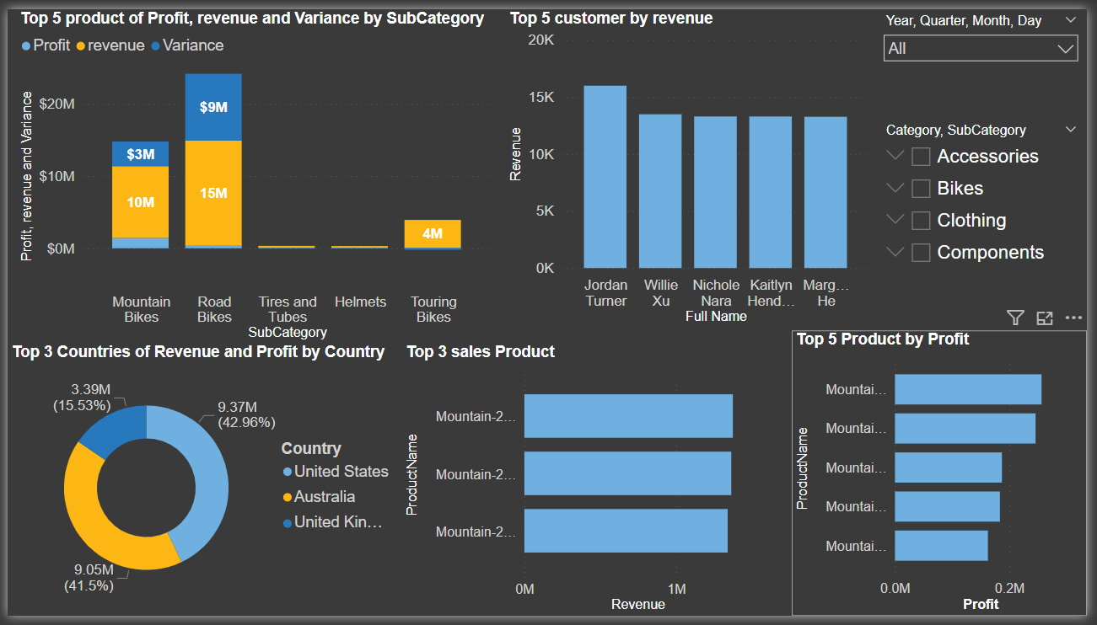
8.Top Analysis

Slide 25
Insgiht
Top 5 Product for profit ,revenue, and variance in subcategory is highest for road bikes.
Top 3 countries for revenue and for profit in country is maximum for united states with 42.96%.
Top 5 customer for revenue is most for Jordan turner.
Top 3 sales product is mountain 200 black 46, mountain 200 black 42,
Mountain 200 silver 38.
Top 5 maximum profit for product is mountain 200 silver 46, Mountain 200 black 46, mountain 200 silver 42, mountain 200 silver 38, Mountain 200 black 42.

Slide 26
Conclusion
Product Performance: Certain product categories consistently outperform others, suggesting opportunities for targeted marketing efforts or adjustments in production and inventory management.
Cost Efficiency: Evaluation of cost-effectiveness in relation to sales performance indicates areas where cost reductions could be made without compromising sales targets.
Budget Accuracy: The comparison between budgeted sales and actual sales figures reveals a [percentage]% variance. This indicates [over/under]performance relative to our projections. The primary drivers of variance include [briefly mention key factors influencing variance].
Product Performance: Certain product lines performed exceptionally well, contributing significantly to overall sales. Conversely, other products showed weaker performance, suggesting opportunities for targeted marketing or operational improvements.

Slide 27
End ……

